Slide 1


Summary of the Week

Slide 2
Content
1. Discussion of the paper topic
2. Discuss the difference between V1 and FL
3. How to write the proof part

Slide 3
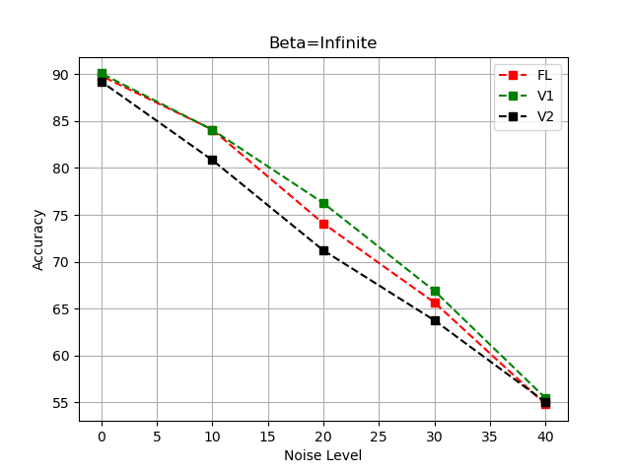
Result of Cifar10
Cifar10
N=100
Beta=infinite

Slide 4
Result of Cifar10
Cifar10
N=100
Beta=0.1

Slide 5
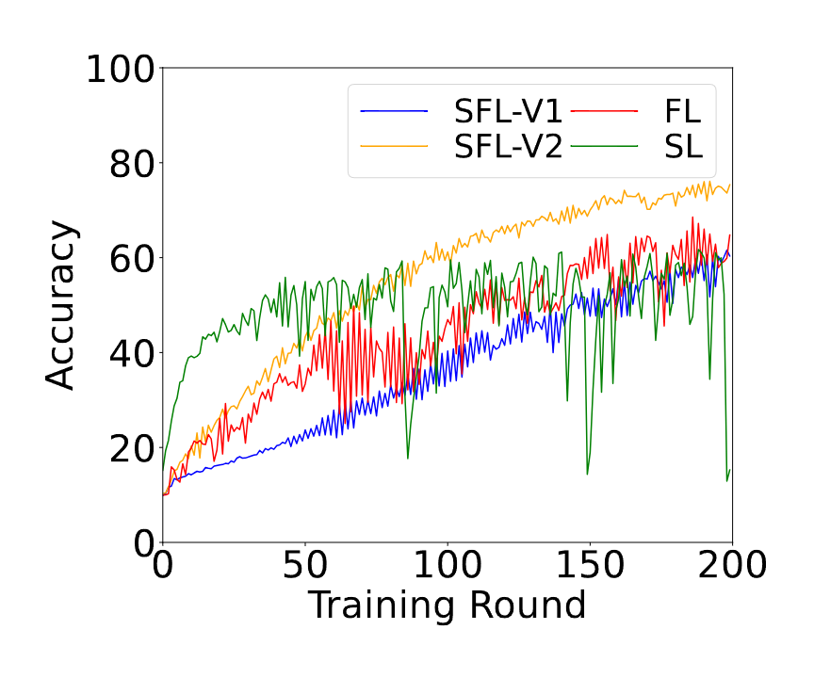
Result of Cifar10
Cifar10
N=100
Beta=0.1

Slide 6
Result of Cifar10
N=100
Beta=0.1

Slide 7
Result of Cifar10
N=100
Beta=0.1

Slide 8
Result of Cifar10
N=100
Beta=0.1

Slide 9
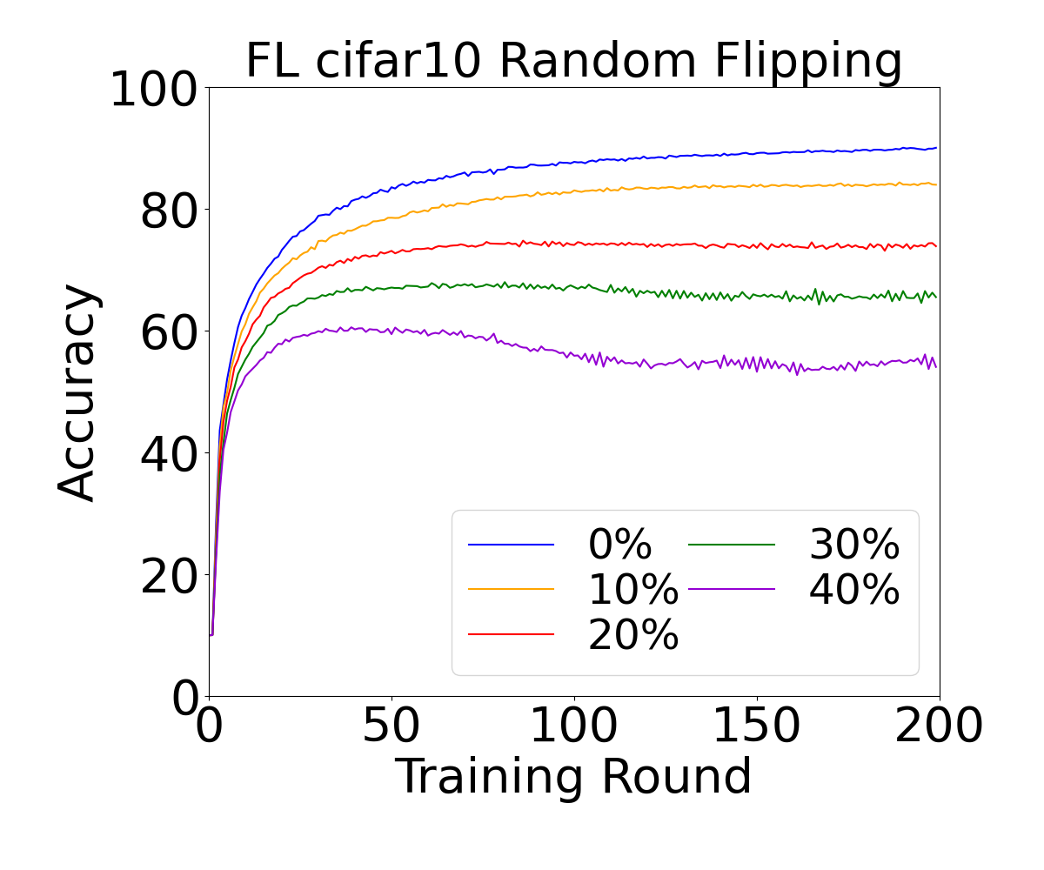
Result of Cifar10
Cifar10
N=100
Beta=infinite

Slide 10
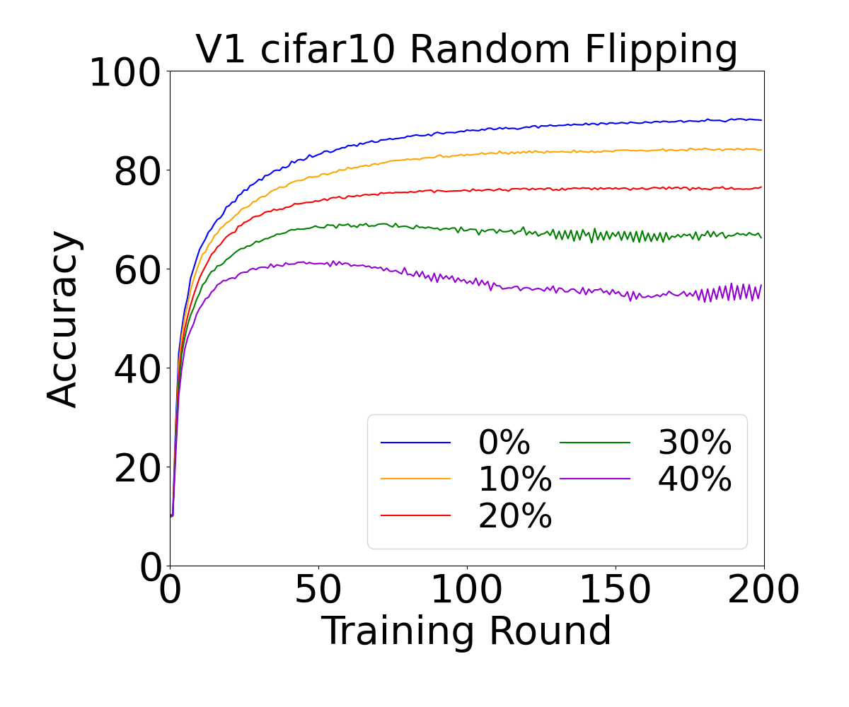
Result of Cifar10
Cifar10
N=100
Beta=infinite

Slide 11
Result of Cifar10
Cifar10
N=100
Beta=infinite

Slide 12
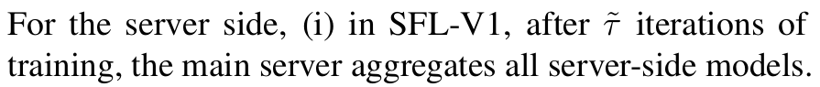
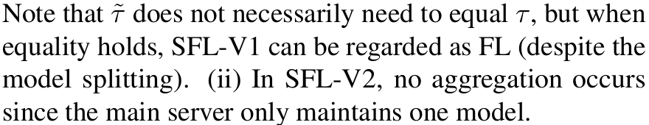
V1 and FL

Slide 13
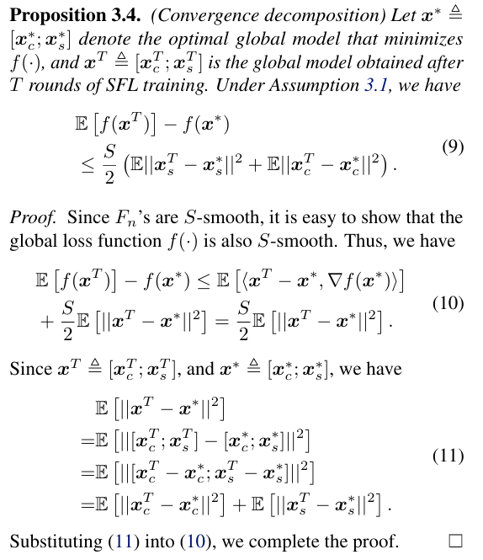
Proof

Slide 14
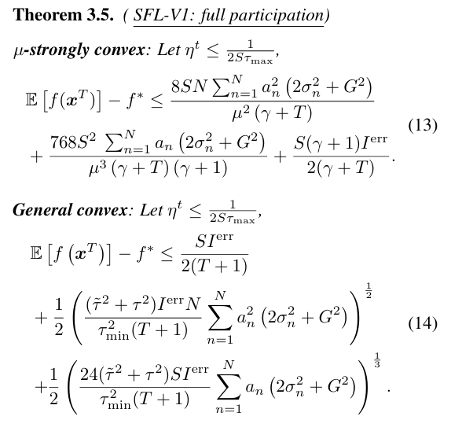
Proof

Slide 15
THANK YOU

